Slide 2
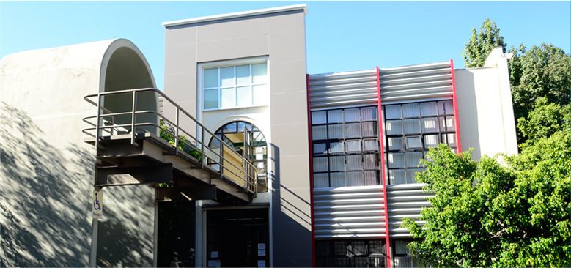
OUR INSTITUTION
Commonly referred to as ITAM, the Instituto Tecnológico Autónomo de México was founded in 1946, as an Economics' school under the leadership of distinguished industrialist, Mr. Raul Bailleres.
Private, non-denominational, non-profit institution of higher education supported completely by students fees and ´private contributions and governed by its own Board of Trustees.
Specialized in the social and managerial sciences and a leading institution in its areas of expertise. It has curricular autonomy and official government recognition of all its programs.
Our alumni network is one of our greatest assets with a vast community of ITAM students playing a central role in government, business, finance, academia and social initiatives.

Slide 3
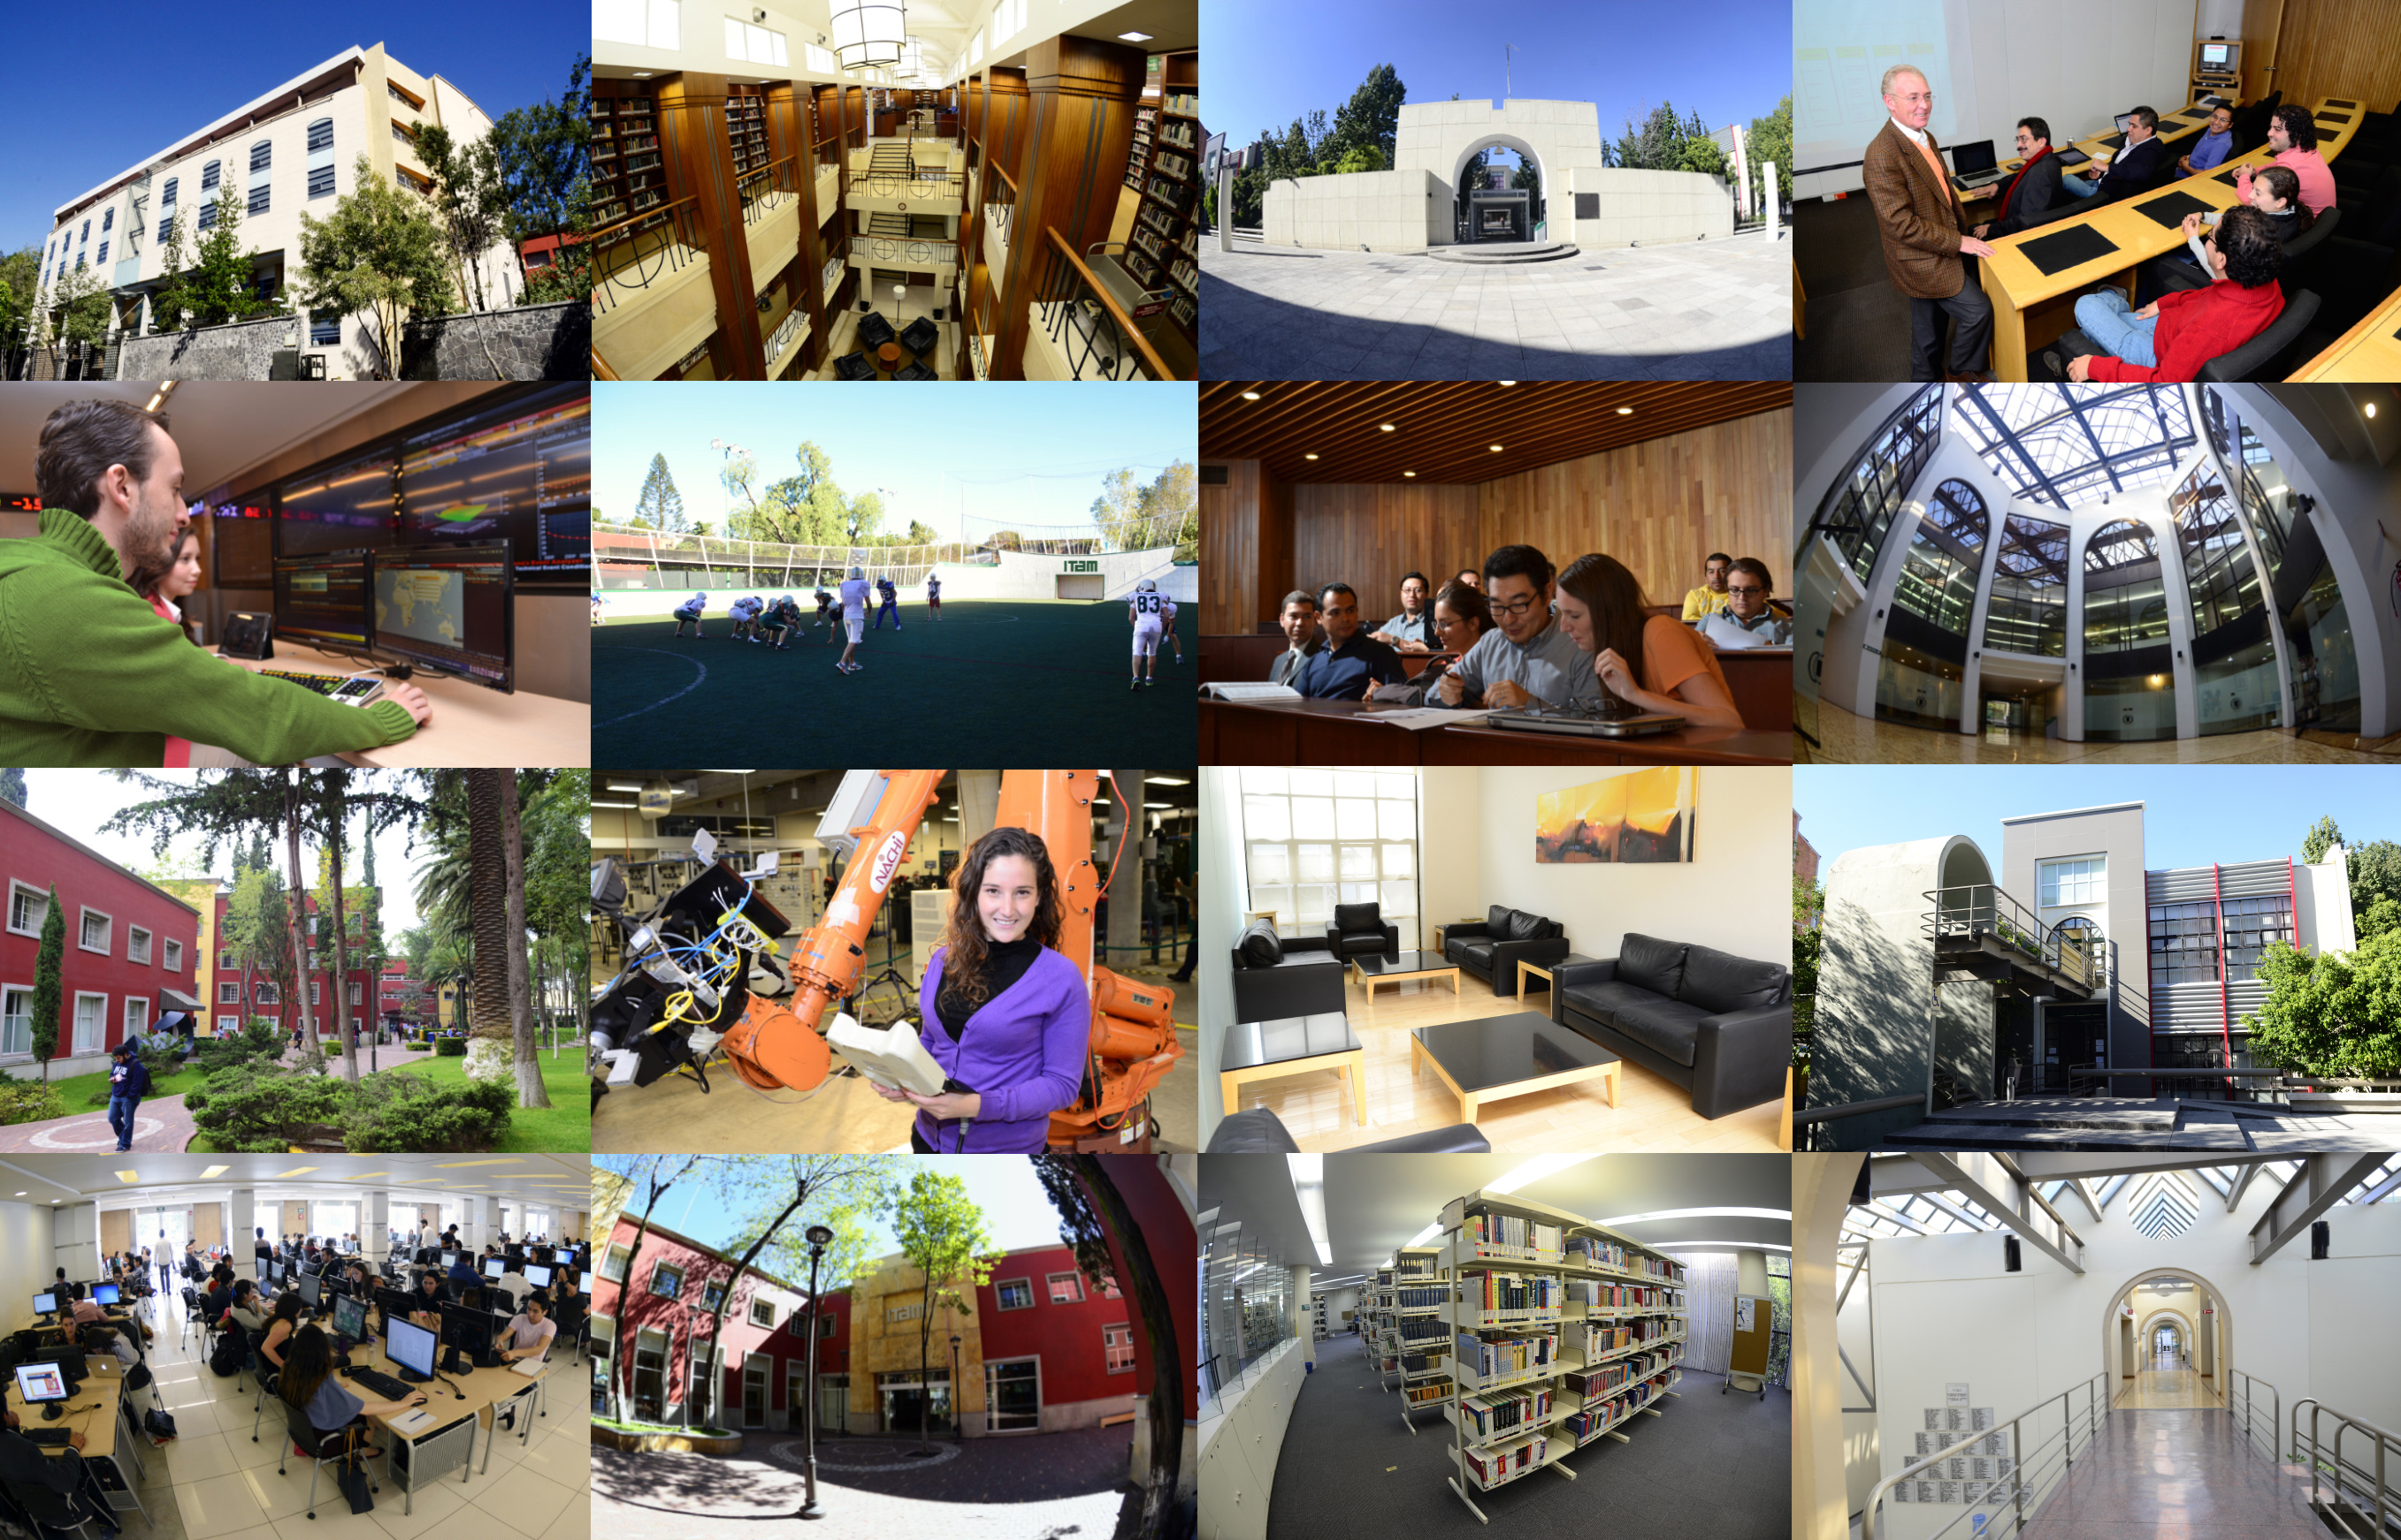
OUR CAMPUSES
ITAM’S campuses are located in the picturesque southern part of Mexico City
Separate campuses for Graduate and Undergraduate studies
Easily accessible by public transportation
Highly-secure, enclosed campuses

Slide 4
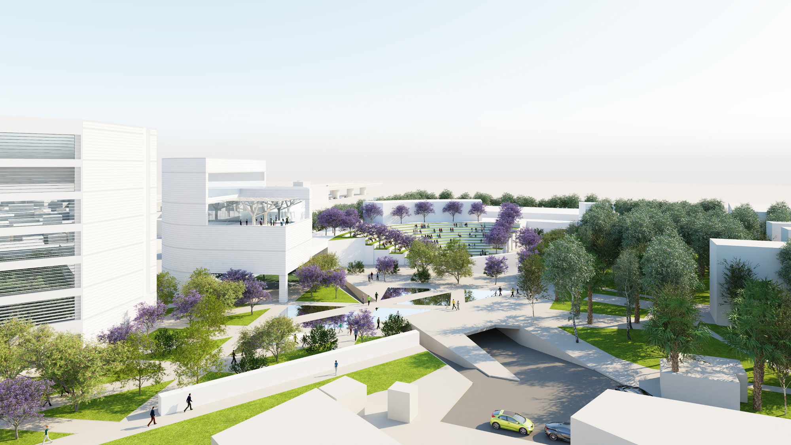
FUTURE CAMPUS

Slide 5
ACADEMIC PROGRAMS
UNDERGRADUATE
Economics
Law
Political Science
International Relations
Accounting
Business Administration
Finance
Actuarial Science
Applied Mathematics
Business Engineering
Computing Engineering
Industrial Engineering
Mechatronics Engineering
Telecommunications Engineering
MASTERS
Administrative Law and Regulation
Human Rights
Economic Theory
Economics
Public Policy
Accounting
Business Administration
Executive MBA
Finance
Ph. D. PROGRAMS
Economics
International Management
Marketing
Data Science
Insurance and Risk Management
Computer Science
Information and Management Technologies
UNIVERSITY EXTENSION
Executive Education
Executive Seminars
Special Courses
Notes:
Bullets?

Slide 6
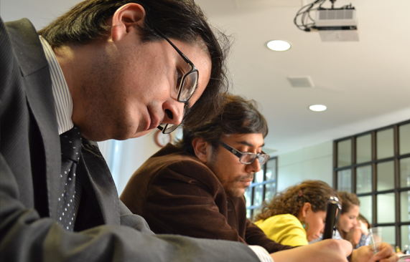
ACCREDITATION
AMONG OTHERS:
All ITAM undergraduate, masters and specialization programs are fully recognized and registered with the Mexican Ministry of Education
Fully accredited under the Federation of Private Institutions of Higher Education (FIMPES)
Our Business School holds the Triple Crown Accreditation
Industrial Engineering, Mechatronics Engineering and Computer Engineering programs accredited by ABET

Slide 7
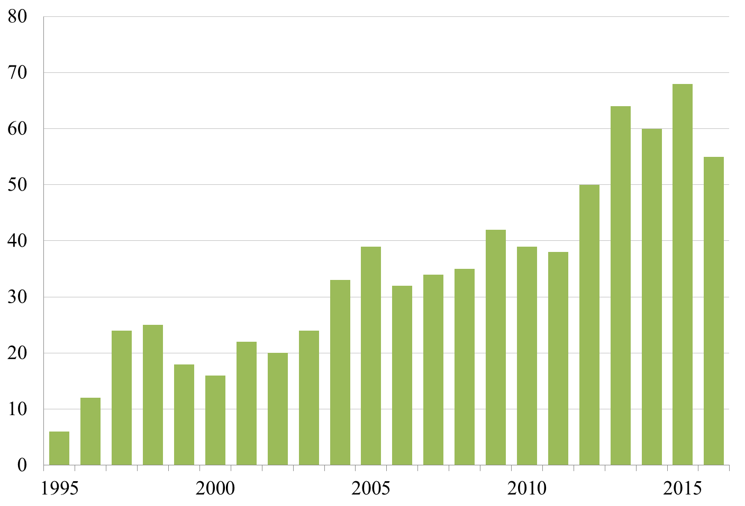
OUR FACULTY
222 full time faculty members
77% with doctoral degree
45% belong to the prestigious Mexican System of Researchers (SNI)
26.4% International Faculty
50% of all courses are taught by Full Time Faculty
More than 400 public and private sector experts as adjunct faculty
Average students per class: 27.4
Average teaching load per year: 4.5 courses
Classes taught by scholars connecting research and education
Scopus - Web of Science Indexed Journals

Slide 10
OUR STUDENTS
Enrollment
Yearly intake of 1,500 students
5,300 undergraduate students
60% from Mexico City
40% from the rest of the country
700 graduate students
Students with a high academic profile
1,380 SAT average
8,000 annual flow in Continuous and Executive Education
25% of graduating class pursue graduate studies abroad
8.4% pursue PhD’s upon graduation
58% employed upon graduation

